Slide 1
Predict survival of patients with heart failure and rank the features corresponding to the most important risk factors
DONE BY:
Bakht Singh Basaram
Sahithi Chindam
Santhoshi Indrakanti
Shanmukha Nadh Uppugandla

Slide 2
Abstract
Cardiovascular diseases kill approximately 17 million people globally every year, and they mainly exhibit as myocardial infarctions and heart failures. Heart failure (HF) occurs when the heart cannot pump enough blood to meet the needs of the body. Available electronic medical records of patients quantify symptoms, body features, and clinical laboratory test values, which can be used to perform biostatistics analysis aimed at highlighting patterns and correlations otherwise undetectable by medical doctors. Machine learning can predict patients’ survival from their data and can individuate the most important features among those included in their medical records.

Slide 3
Objective:
The main objective of this study is to estimate death rates due to heart failure and to investigate its link with some major risk factors by choosing a dataset of medical record which contains 299 patients having heart failure.

Slide 4
Dataset Description:
The dataset describes the medical records of 299 heart failure patients collected during the April-December 2015 at the Faisalabad Institute of Cardiology.
There are six categorical columns (anemia, diabetes, high blood pressure, sex, smoking, death event) and seven numerical columns (age, creatinine phosphokinase, ejection fraction, platelets, serum creatinine, serum sodium, time). All 299 patients had prior heart failure and left ventricular systolic dysfunction.
https://archive.ics.uci.edu/ml/datasets/Heart+failure+clinical+records

Slide 5
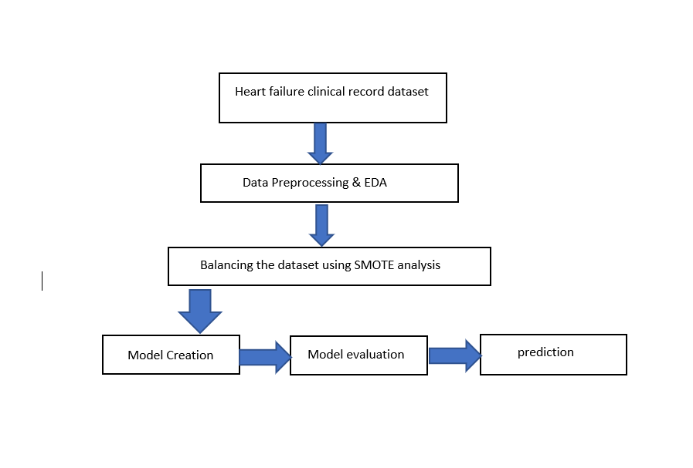
Workflow

Slide 6
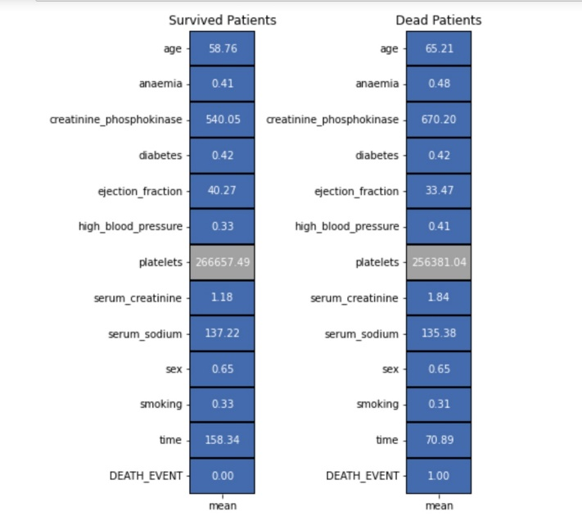
Data processing & EDA:

Slide 7
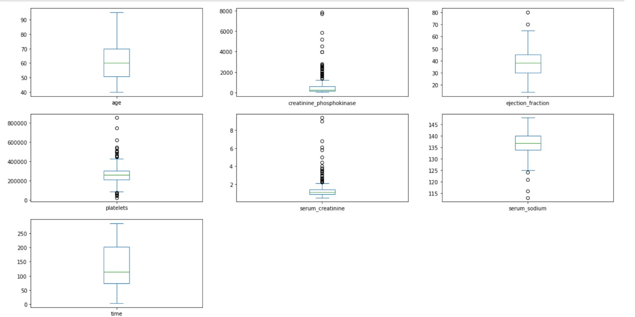
Distributions of Numerical Features

Slide 8
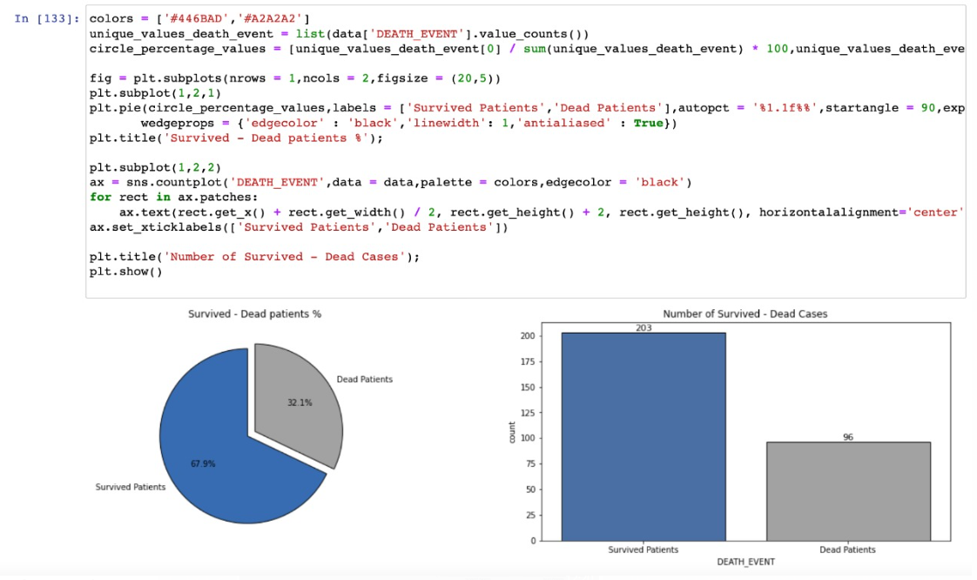
Visualization of Output Variable:

Slide 9
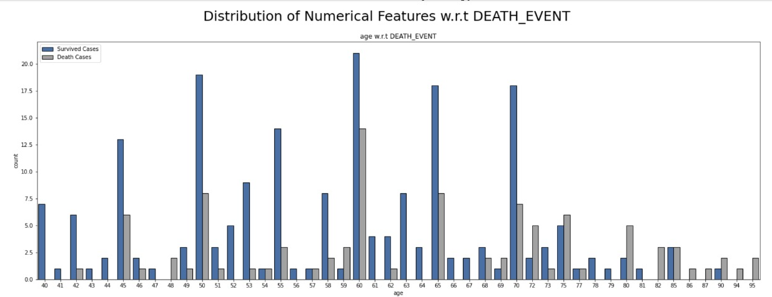
Distribution of numerical features with respect to DEATH_EVENT

Slide 10
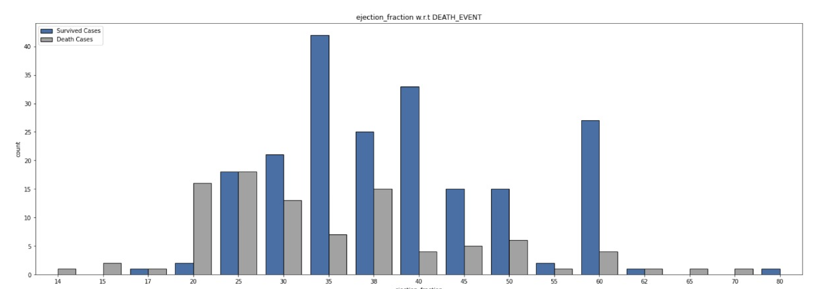

Slide 11
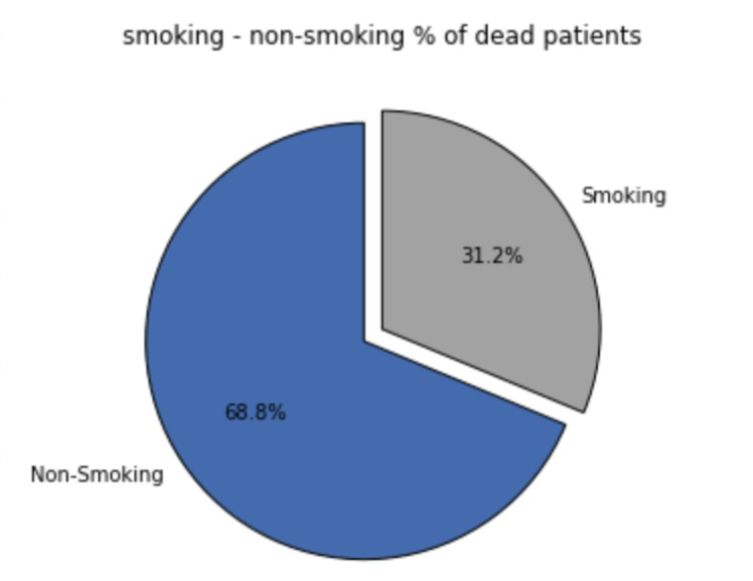
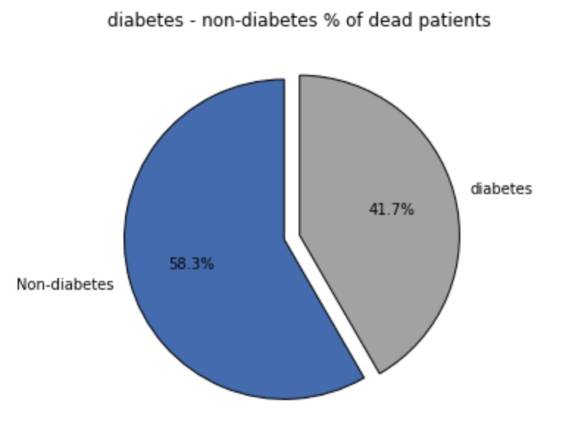

Slide 12
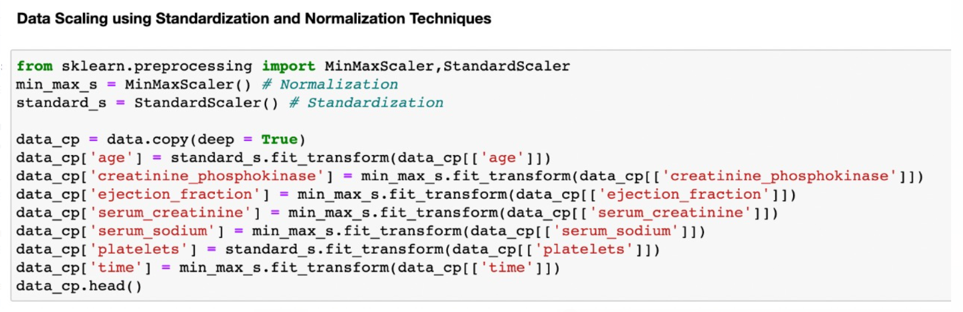
Data Methods & Modelling

Slide 13
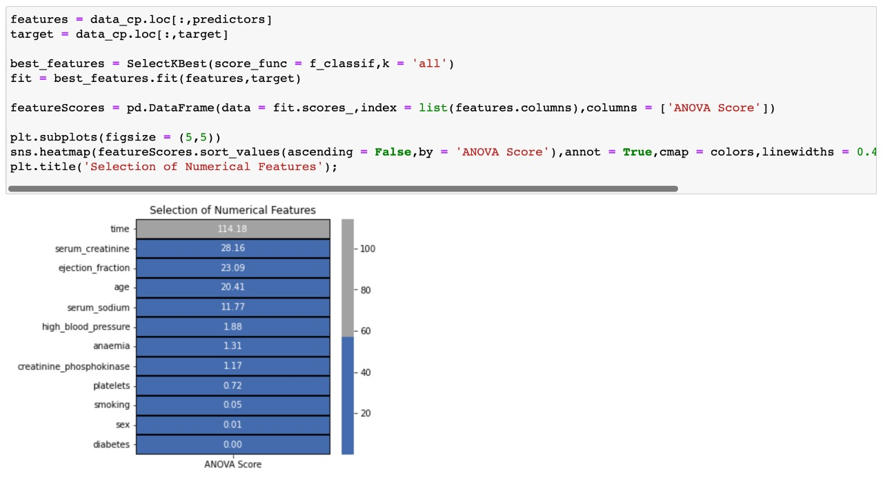
Feature selection

Slide 14
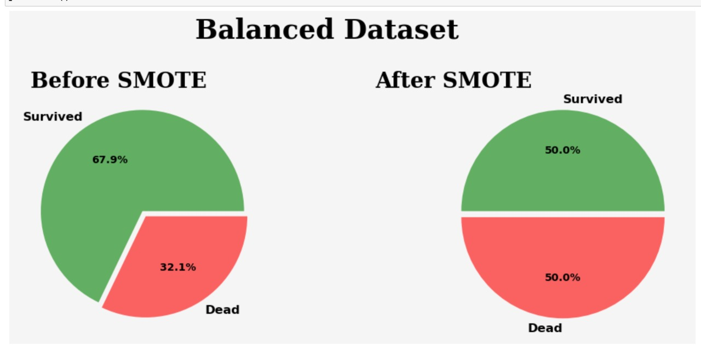
Balancing the dataset using SMOTE:

Slide 15
Machine Learning methods
Logistic Regression
Gaussian Naive Bayes Classifier
Random Forest Classifier
KNN Classifier

Slide 16
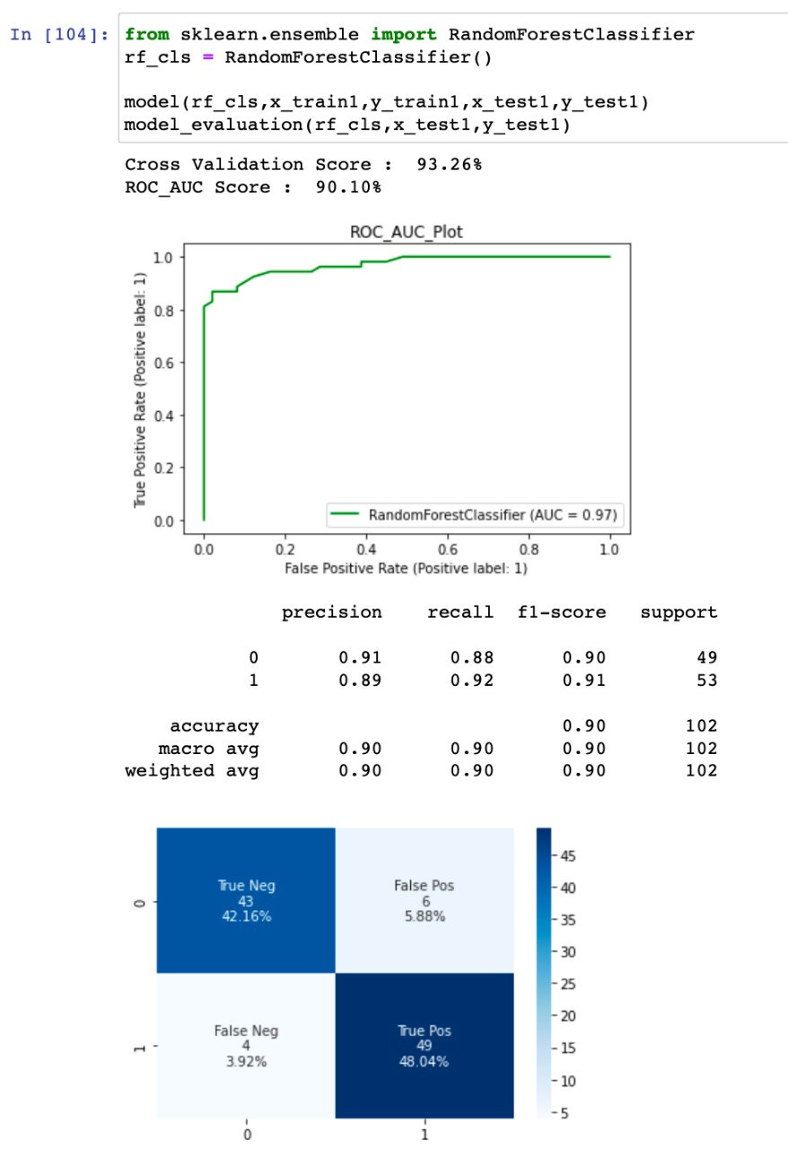
Evaluation metrics:
Prediction results:
Our prediction results show that random forest significantly outperforms when compared with all other methods by obtaining top accuracy i.e., 0.92 with ROC_AUC_Score of 92.14% and a cross validation score of 93.24%.

Slide 17
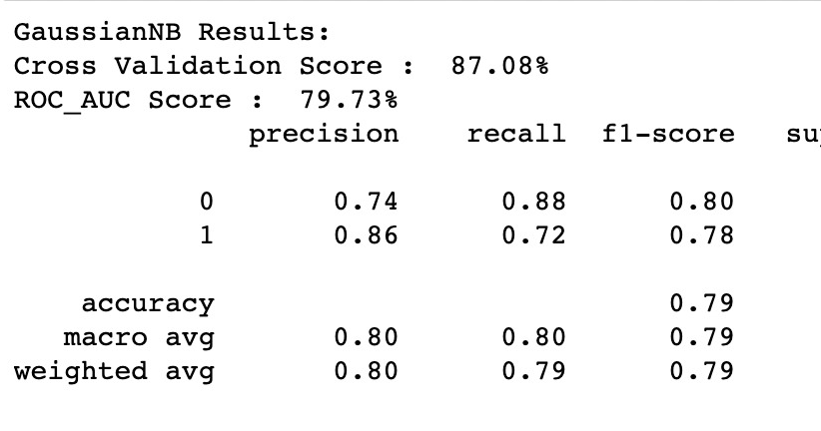
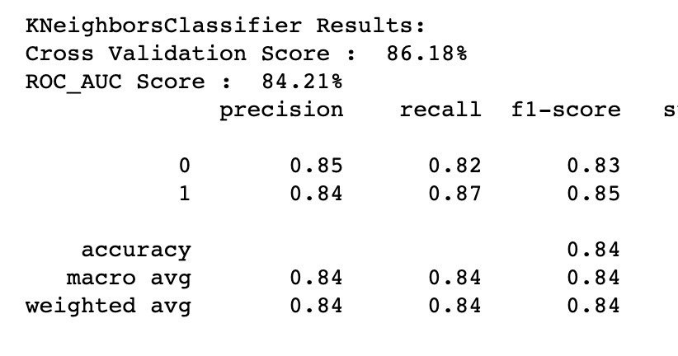
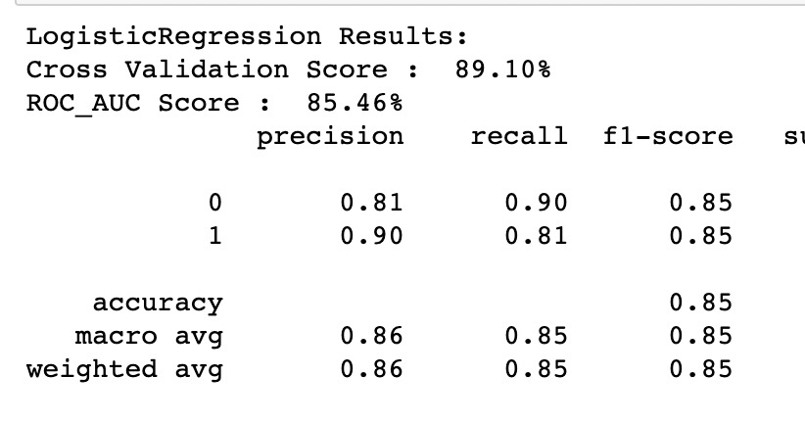

Slide 18
Conclusion:
In conclusion, these findings could have an impact on clinical practice by giving doctors a new tool which helps them to determine whether a patient with heart failure will survive or not. Serum creatinine and ejection fraction may be the key areas of concentration for medical practitioners that are trying to determine whether a patient will survive after heart failure.

Slide 19
References:
https://bmcmedinformdecismak.biomedcentral.com/articles/10.1186/s12911-020-1023-5
https://archive.ics.uci.edu/ml/datasets/Heart+failure+clinical+records
https://www.kaggle.com/code/tanmay111999/diabetes-classification-xgb-lgbm-stack-smote
https://towardsdatascience.com/understanding-auc-roc-curve-68b2303cc9c5#:~:text=the%20multiclass%20model%3F-,What%20is%20the%20AUC%20%2D%20ROC%20Curve%3F,capable%20of%20distinguishing%20between%20classes.
https://towardsdatascience.com/cross-validation-explained-evaluating-estimator-performance-e51e5430ff85

